Slide 1
CS 295A/395D: Artificial Intelligence
More MDPs
Prof. Emma Tosch
27 April 2022

Slide 2
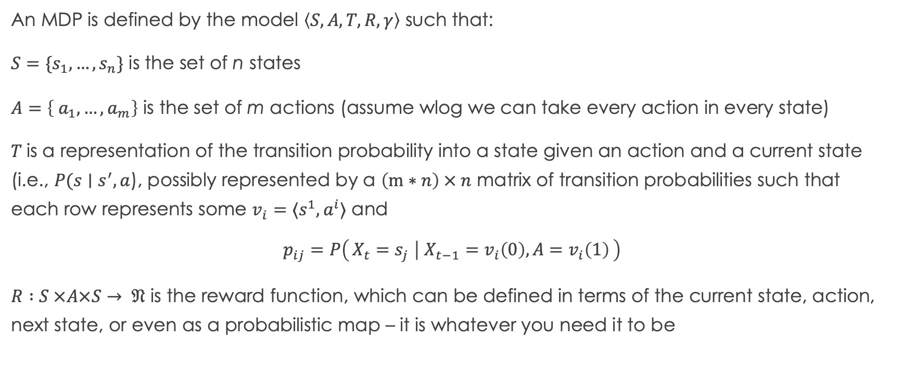
Recall: MDPs
An MDP is defined by the model $\left\langle S, A, T, R, γ\right\rangle$ such that:
$S=\{s_{1},…, s_{n}\}$ is the set of n states
$A=\left\{ a_{1},…, a_{m}\right\}$ is the set of m actions (assume wlog we can take every action in every state)
$T$is a representation of the transition probability into a state given an action and a current state (i.e., $P(s∣s^{′}, a$), possibly represented by a $\left(m∗n\right) × n$ matrix of transition probabilities such that each row represents some $v_{i}=⟨s^{1},a^{i}⟩$ and
$$p_{ij}=P\left(X_{t}=s_{j} ∣ X_{t−1}=v_{i}\left(0\right), A=v_{i}\left(1\right)\right)$$
$R :S ×A×S→ 𝔑$ is the reward function, which can be defined in terms of the current state, action, next state, or even as a probabilistic map – it is whatever you need it to be

Slide 3

Recall: LTL Example
s4
s3
p, q
p, r
Example:
p = Yar alive
q = Yar on our ship
r = transporter ready
s1
p, q, r
p
s2
r
s6
s5

Slide 4
LTL Exercises
Some state transitions are associated with
actions we take
s4
s3
p, q
p, r
Example:
p = Yar alive
q = Yar on our ship
r = transporter ready
s1
p, q, r
p
s2
r
s6
s5
Remaining transitions associated with environment dynamics

Slide 5
s4
s3
p, q
p, r
s1
p, q, r
p
s2
r
s6
s5

Slide 6
LTL Exercises
Orange = use transporter
s4
s3
p, q
p, r
Example:
p = Yar alive
q = Yar on our ship
r = transporter ready
s1
p, q, r
p
s2
r
s6
s5
Remaining transitions associated with environment dynamics

Slide 7
LTL Exercises
Orange = use transporter
s4
s3
p, q
p, r
Assign transition probabilities, starting with (s1, a1)
Example:
p = Yar alive
q = Yar on our ship
r = transporter ready
s1
p, q, r
p
s2
r
s6
s5
Blue = do nothing

Slide 8
Transporter as MDP
Orange = use transporter
s4
s3
p, q
p, r
Now: taking a2 (do nothing) in s1
Actions: Orange (a1), Blue (a2)
P(s1 | s1, a1) = 0
P(s2 | s1, a1) = 1
P(s3 | s1, a1) = 0
P(s4 | s1, a1) = 0
P(s5 | s1, a1) = 0
P(s6 | s1, a1) = 0
s1
p, q, r
p
s2
r
s6
s5
Blue = do nothing

Slide 9
Transporter as MDP
Orange = use transporter
s4
s3
p, q
p, r
Now: taking a2 (do nothing) in s1
Actions: Orange (a1), Blue (a2)
P(s1 | s1, a2) = 0.8
P(s2 | s1, a2) = 0
P(s3 | s1, a2) = 0
P(s4 | s1, a2) = 0
P(s5 | s1, a2) = 0.1
P(s6 | s1, a2) = 0.1
s1
p, q, r
p
s2
r
s6
s5
Blue = do nothing

Slide 10
Transporter as MDP
Orange = use transporter
s4
s3
p, q
p, r
Now: taking a1 in s1
Actions: Orange (a1), Blue (a2)
P(s1 | s2, a1) = 0
P(s2 | s2, a1) = 0
P(s3 | s2, a1) = 0
P(s4 | s2, a1) = 0
P(s5 | s2, a1) = 0
P(s6 | s2, a1) = 0
Not a valid probability distribution!
s1
p, q, r
p
s2
r
s6
s5
Blue = do nothing

Slide 11
Transporter as MDP
Orange = use transporter
s4
s3
p, q
p, r
Actions: Orange (a1), Blue (a2)
P(s1 | s2, a1) = 0
P(s2 | s2, a1) = 0
P(s3 | s2, a1) = 0
P(s4 | s2, a1) = 0
P(s5 | s2, a1) = 0
P(s6 | s2, a1) = 0
Illustrates difference between event space vs. 0% event
s1
p, q, r
p
s2
r
s6
s5
Blue = do nothing

Slide 12
Transporter as MDP
Orange = use transporter
s4
s3
p, q
p, r
Actions: Orange (a1), Blue (a2)
P(s1 | s2, a1) = 1
P(s2 | s2, a1) = 0
P(s3 | s2, a1) = 0
P(s4 | s2, a1) = 0
P(s5 | s2, a1) = 0
P(s6 | s2, a1) = 0
Could make up junk…why is this a bad idea?
s1
p, q, r
p
s2
r
s6
s5
Blue = do nothing

Slide 13
Transporter as MDP
Orange = use transporter
s4
s3
p, q
p, r
Actions: Orange (a1), Blue (a2)
P(s1 | s2, a1) = 0
P(s2 | s2, a1) = 0
P(s3 | s2, a1) = 0
P(s4 | s2, a1) = 0
P(s5 | s2, a1) = 0
P(s6 | s2, a1) = 0
Illustrates another reason why we define A to be a map!
s1
p, q, r
p
s2
r
s6
s5
Blue = do nothing

Slide 14
Transporter as MDP
Orange = use transporter
s4
s3
p, q
p, r
Actions: Orange (a1), Blue (a2)
P(s1 | s2, a2) = 0
P(s2 | s2, a2) = 0.5
P(s3 | s2, a2) = 0.4
P(s4 | s2, a2) = 0
P(s5 | s2, a2) = 0
P(s6 | s2, a2) = 0.1
s1
p, q, r
p
s2
r
s6
s5
Blue = do nothing

Slide 15
Transporter as MDP
Orange = use transporter
s4
s3
p, q
p, r
Actions: Orange (a1), Blue (a2)
P(s1 | s3, a1) = 0
P(s2 | s3, a1) = 0
P(s3 | s3, a1) = 0.1
P(s4 | s3, a1) = 0.9
P(s5 | s3, a1) = 0
P(s6 | s3, a1) = 0
What if sometimes the transporter doesn’t work?
s1
p, q, r
p
s2
r
s6
s5
Blue = do nothing

Slide 16
Sources of randomness and variability
Environment dynamics :
Aleatory: Probabilistic transitions between states
Epistemic: Uncertainty over state values
Probability of action succeeding vs. taking an action
Former: Can also be modeled as environmental!
Latter: Randomness comes from the agent
POMDP
MDP
RL

Slide 17
MDPs vs RL
MDPs
Problem: Sequential Decision-Making
Domain: environments having a particular property (Markovian)
Describes framework over which to search for decisions in that environment
RL
Problem: Learning to act over time (agent-based)
Domain: any environment that emits a signal
Describes a framework for learning over sequences

Slide 18
Transporter as MDP
Orange = use transporter
s4
s3
p, q
p, r
Missing reward!
But first…
Actions: Orange (a1), Blue (a2)
P(s1 | s3, a1) = 0.9
P(s2 | s3, a1) = 0
P(s3 | s3, a1) = 0.1
P(s4 | s3, a1) = 0
P(s5 | s3, a1) = 0
P(s6 | s3, a1) = 0
s1
p, q, r
p
s2
r
s6
s5
Blue = do nothing

Slide 19
What does it mean to be in a particular state?
State completely abstracted in the MDP framework
How do we know we are in a particular state?
This is a deep question that connects back to the ontology discussion at the start of the semester
Recall: extensional vs. intensional definitions of sets
Now: intensional (assume we can read features that allow us to evaluate predicates…)

Slide 20
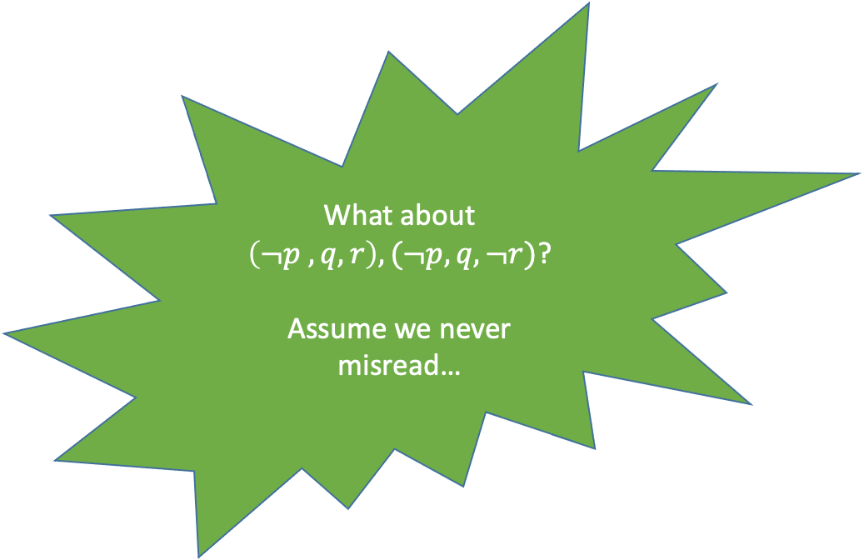
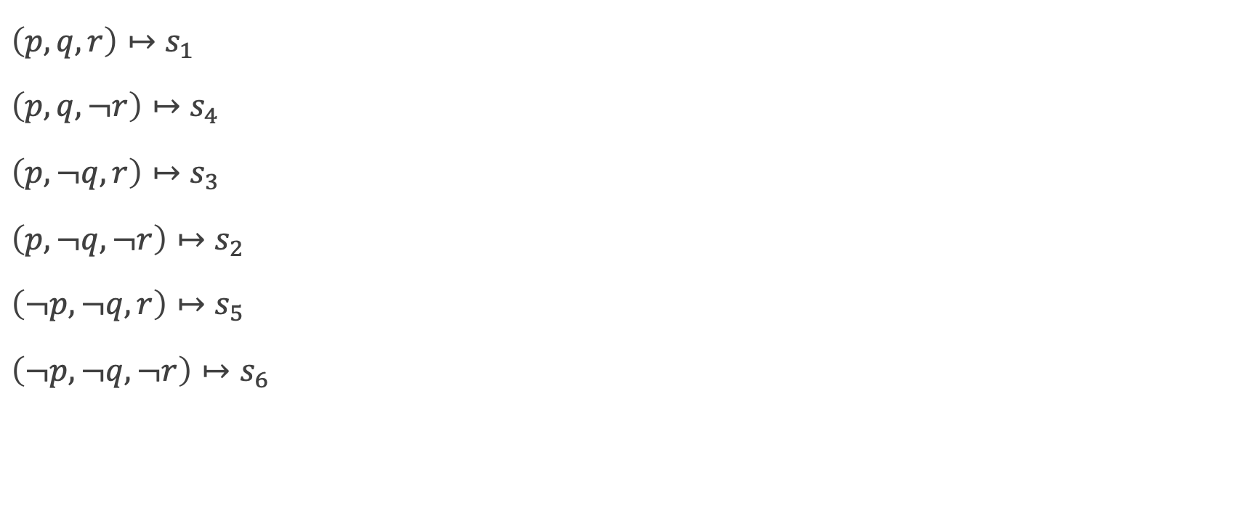
Transporter as MDP
Orange = use transporter
s4
s3
What about $\left(¬p , q, r\right), (¬p, q, ¬r)$?
Assume we never misread…
p, q
p, r
$$\left(p, q, r\right)↦s_{1}$$
$$\left(p, q, ¬r\right)↦s_{4}$$
$$\left(p, ¬q, r\right)↦s_{3}$$
$$\left(p, ¬q, ¬r\right)↦s_{2}$$
$$\left(¬p, ¬q, r\right)↦s_{5}$$
$$\left(¬p, ¬q, ¬r\right)↦s_{6}$$
s1
p, q, r
p
s2
r
s6
s5
Blue = do nothing

Slide 21
Transporter as MDP
Orange = use transporter
s4
s3
What about $\left(¬p , q, r\right), (¬p, q, ¬r)$?
Assume we never misread…
p, q
p, r
$$\left(p, q, r\right)↦s_{1}$$
$$\left(p, q, ¬r\right)↦s_{4}$$
$$\left(p, ¬q, r\right)↦s_{3}$$
$$\left(p, ¬q, ¬r\right)↦s_{2}$$
$$\left(¬p, ¬q, r\right)↦s_{5}$$
$$\left(¬p, ¬q, ¬r\right)↦s_{6}$$
s1
p, q, r
p
s2
r
s6
s5
Blue = do nothing

Slide 22
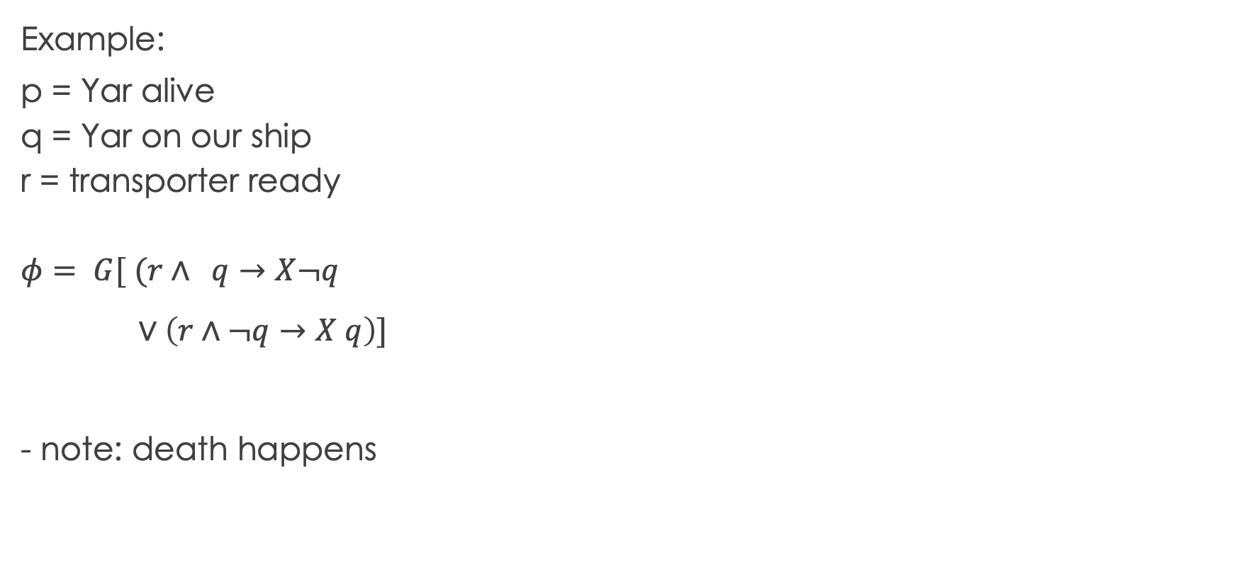
Transporter Policy
Orange = use transporter
s4
s3
p, q
p, r
Example:
p = Yar alive
q = Yar on our ship
r = transporter ready
$$φ= G[ (r∧ q→X¬q$$
$∨\left(r∧¬q→X q\right)]$
- note: death happens
s1
p, q, r
p
s2
r
s6
s5
Blue = do nothing

Slide 23
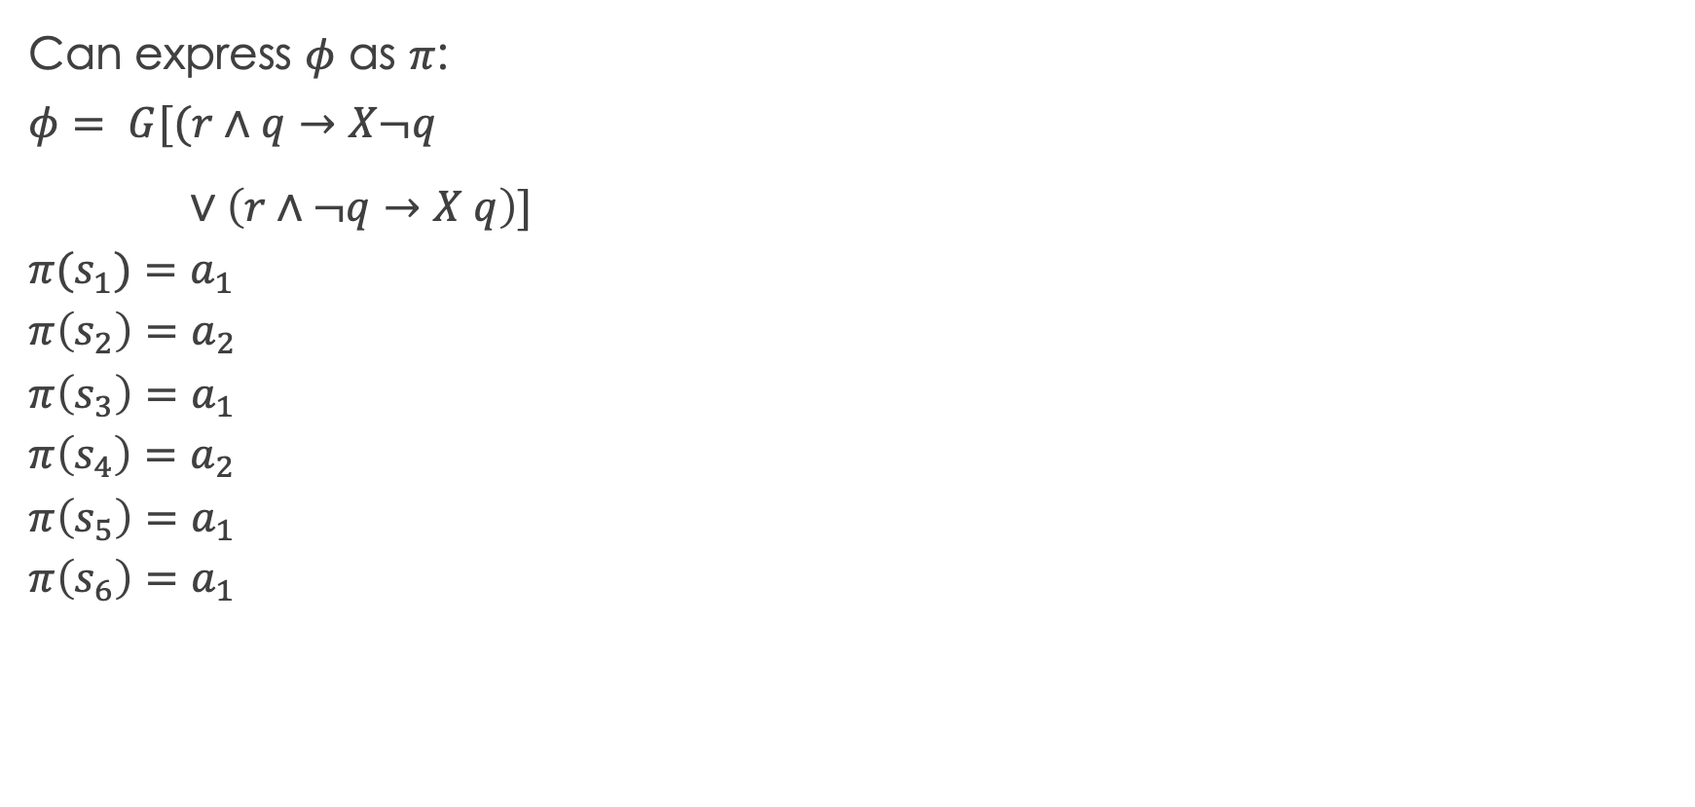
Transporter Policy
Orange = use transporter
s4
s3
p, q
p, r
Can express $φ$ as $π$:
$$φ= G[(r∧q→X¬q$$
$∨\left(r∧¬q→X q\right)]$
$$π(s_{1})=a_{1}$$
$$π\left(s_{2}\right)=a_{2}$$
$$π\left(s_{3}\right)=a_{1}$$
$$π\left(s_{4}\right)=a_{2}$$
$$π\left(s_{5}\right)=a_{1}$$
$$π\left(s_{6}\right)=a_{1}$$
s1
p, q, r
p
s2
r
s6
s5
Blue = do nothing

Slide 24
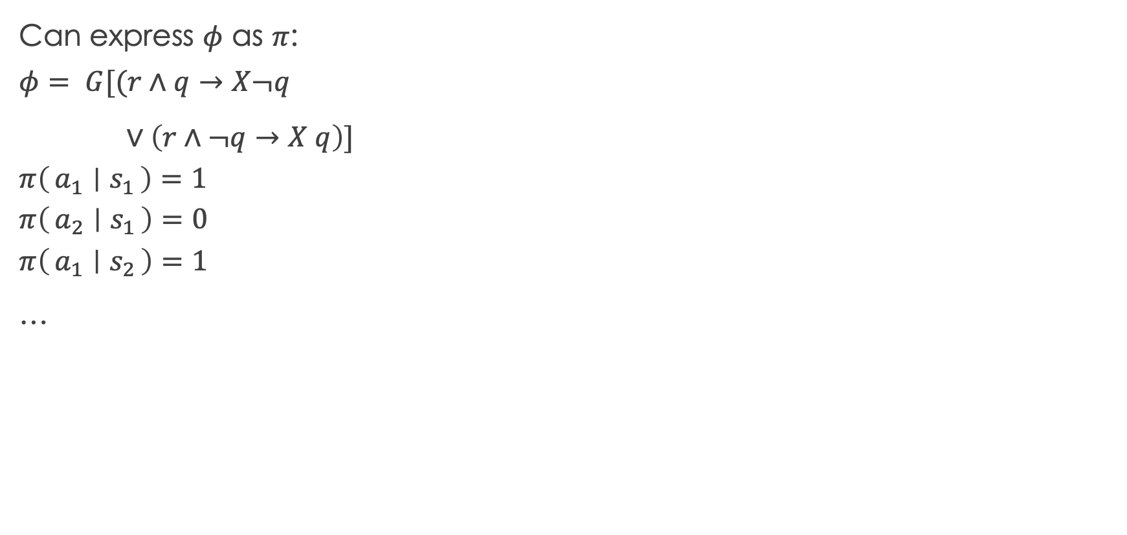
Transporter Policy
Orange = use transporter
s4
s3
p, q
p, r
Can express $φ$ as $π$:
$$φ= G[(r∧q→X¬q$$
$∨\left(r∧¬q→X q\right)]$
$$π\left(a_{1} ∣ s_{1}\right)=1$$
$$π\left(a_{2} ∣ s_{1}\right)=0$$
$$π\left(a_{1} ∣ s_{2}\right)=1$$
…
s1
p, q, r
p
s2
r
s6
s5
Blue = do nothing

Slide 25

Transporter Policy
Orange = use transporter
s4
s3
p, q
p, r
Can express $φ$ as $π$:
$$φ= G[(r∧q→F¬q$$
$∨\left(r∧¬q→F q\right)]$
$$π\left(a_{1} ∣ s_{1}\right)=1$$
$$π\left(a_{2} ∣ s_{1}\right)=0$$
$$π\left(a_{1} ∣ s_{2}\right)=1$$
…
s1
p, q, r
p
s2
r
s6
s5
Blue = do nothing

Slide 26
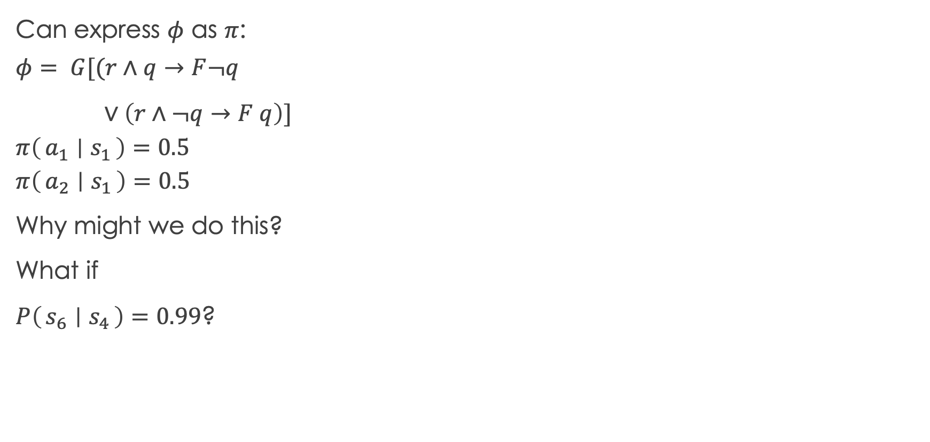
Transporter Policy
Orange = use transporter
s4
s3
p, q
p, r
Missing reward!
Can express $φ$ as $π$:
$$φ= G[(r∧q→F¬q$$
$∨\left(r∧¬q→F q\right)]$
$$π\left(a_{1} ∣ s_{1}\right)=0.5$$
$$π\left(a_{2} ∣ s_{1}\right)=0.5$$
Why might we do this?
What if
$P\left(s_{6} ∣ s_{4}\right)=0.99$?
s1
p, q, r
p
s2
r
s6
s5
Blue = do nothing

Slide 27
Transporter Policy
Orange = use transporter
s4
s3
p, q
p, r
Can express $φ$ as $π$:
$$φ= G[(r∧q→F¬q$$
$∨\left(r∧¬q→F q\right)]$
$$π\left(a_{1} ∣ s_{1}\right)=0.5$$
$$π\left(a_{2} ∣ s_{1}\right)=0.5$$
Why might we do this?
What if
$P\left(s_{6} ∣ s_{4}\right)=0.99$?
s1
p, q, r
p
s2
-10
-10
s6
s5
Blue = do nothing

Slide 28
Transporter Policy
Orange = use transporter
s4
s3
p, q
p, r
Can express $φ$ as $π$:
$$φ= G[(r∧q→F¬q$$
$∨\left(r∧¬q→F q\right)]$
$$π\left(a_{1} ∣ s_{1}\right)=0.5$$
$$π\left(a_{2} ∣ s_{1}\right)=0.5$$
Why might we do this?
What if
$P\left(s_{6} ∣ s_{4}\right)=0.99$?
s1
(5, 3)
p
s2
-10
-10
s6
s5
Blue = do nothing

Slide 29
Transporter Policy
Orange = use transporter
s4
s3
p, q
p, r
Can express $φ$ as $π$:
$$φ= G[(r∧q→F¬q$$
$∨\left(r∧¬q→F q\right)]$
$$π\left(a_{1} ∣ s_{1}\right)=0.5$$
$$π\left(a_{2} ∣ s_{1}\right)=0.5$$
Why might we do this?
What if
$P\left(s_{6} ∣ s_{4}\right)=0.99$?
s1
(5, 3)
2
s2
-10
-10
s6
s5
Blue = do nothing

Slide 30
Transporter Policy
Orange = use transporter
s4
s3
p, q
(50,
-1)
Can express $φ$ as $π$:
$$φ= G[(r∧q→F¬q$$
$∨\left(r∧¬q→F q\right)]$
$$π\left(a_{1} ∣ s_{1}\right)=0.5$$
$$π\left(a_{2} ∣ s_{1}\right)=0.5$$
Why might we do this?
What if
$P\left(s_{6} ∣ s_{4}\right)=0.99$?
s1
(5, 3)
2
s2
-10
-10
s6
s5
Blue = do nothing

Slide 31
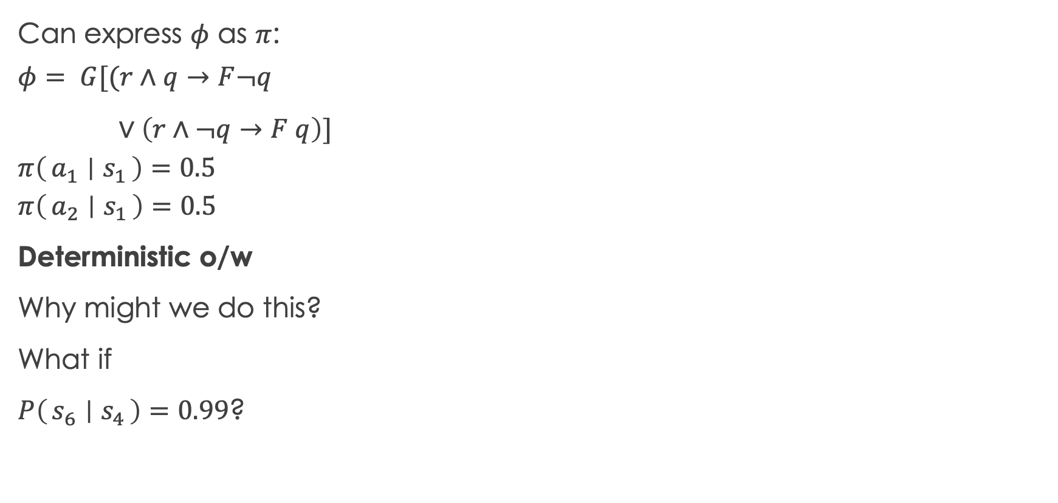
Transporter Policy
Orange = use transporter
s4
s3
20
(50,
-1)
How do we know how good this is?
Can express $φ$ as $π$:
$$φ= G[(r∧q→F¬q$$
$∨\left(r∧¬q→F q\right)]$
$$π\left(a_{1} ∣ s_{1}\right)=0.5$$
$$π\left(a_{2} ∣ s_{1}\right)=0.5$$
Deterministic o/w
Why might we do this?
What if
$P\left(s_{6} ∣ s_{4}\right)=0.99$?
s1
(5, 3)
2
s2
-10
-10
s6
s5
Blue = do nothing

Slide 32
Recall: decision theory computed expected utility over the tree
What is the equivalence construct for MDPs?

Slide 33
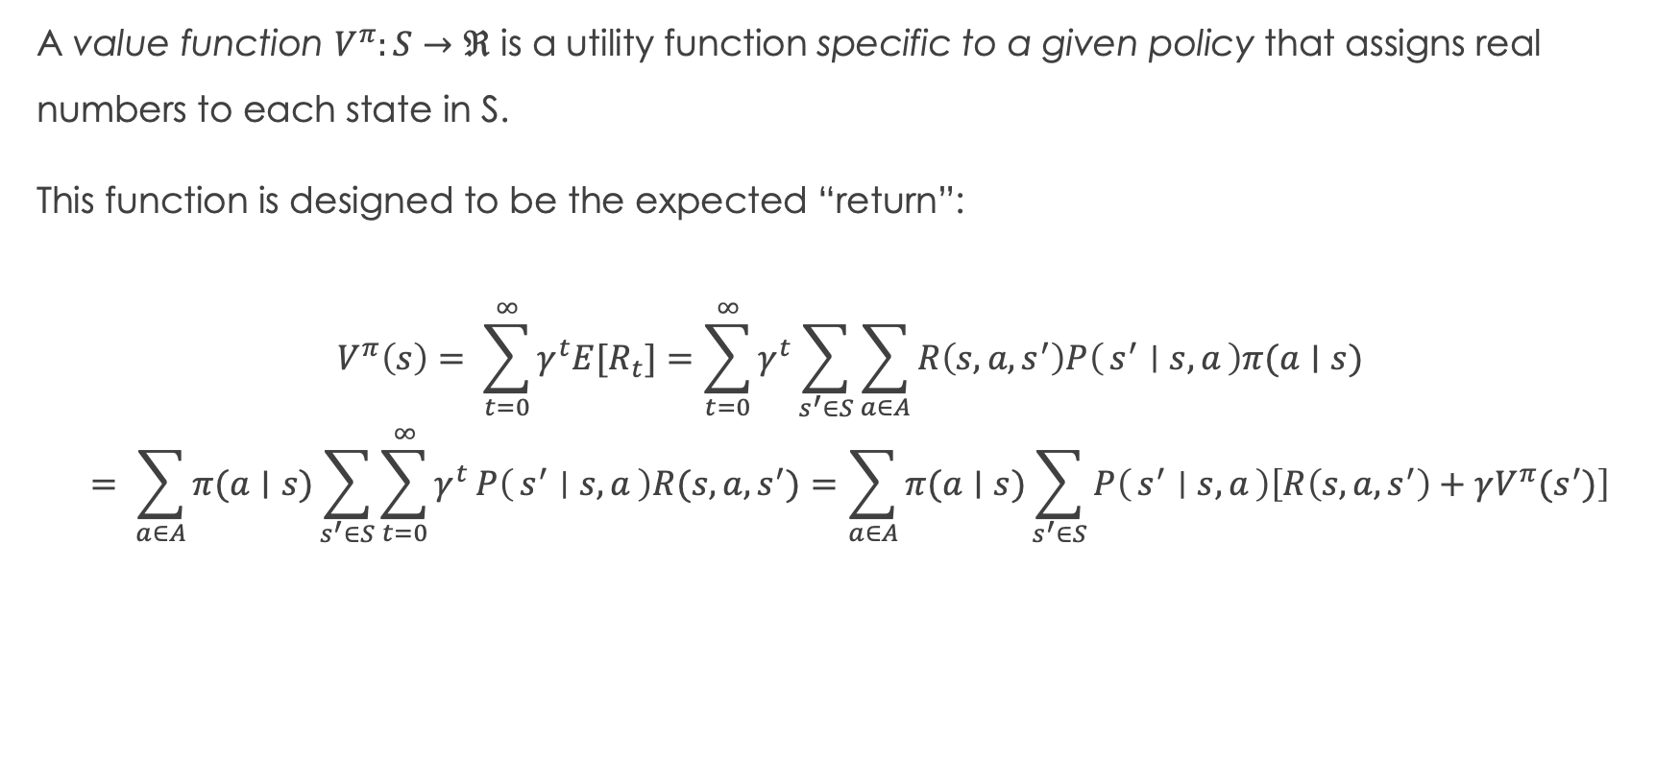
Value Functions
A value function $V^{π}:S→ℜ$ is a utility function specific to a given policy that assigns real numbers to each state in S.
This function is designed to be the expected “return”:
$$V^{π}\left(s\right)= \sum_{t=0}^{∞}{γ^{t}E[R_{t}}]=\sum_{t=0}^{∞}{γ^{t}\sum_{s^{′}∈S}{\sum_{a∈A}{R\left(s, a, s^{′}\right)P\left(s^{′} ∣ s, a\right)π(a∣s)}}}$$
$$= \sum_{a∈A}{π(a∣s)\sum_{s^{′}∈S}{\sum_{t=0}^{∞}{γ^{t}}P\left(s^{′} ∣ s, a\right)R(s, a, s^{′})}}=\sum_{a∈A}{π(a∣s)\sum_{s^{′}∈S}{P\left(s^{′} ∣ s, a\right)\left[R\left(s, a, s^{′}\right)+γV^{π}(s^{′})\right]}}$$

Slide 34
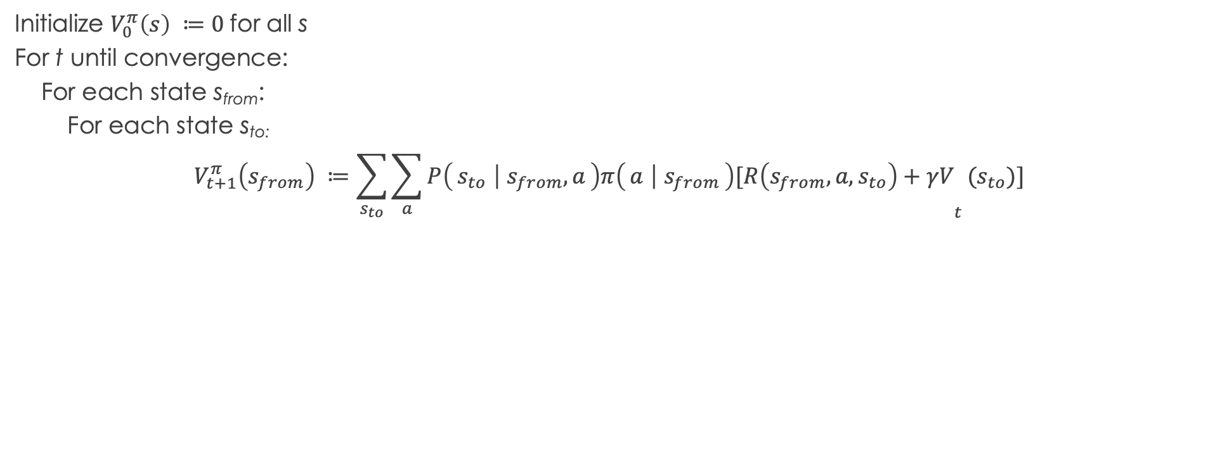
“Policy Evaluation” : Inferring the value function
Initialize $V_{0}^{π}\left(s\right) ≔0$for all s
For t until convergence:
For each state s_{from}:
For each state s_{to:}
$$V_{t+1}^{π}\left(s_{from}\right) ≔\sum_{s_{to}}{{\sum_{a}{P\left(s_{to} ∣ s_{from}, a\right)π\left(a ∣ s_{from}\right)[R\left(s_{from}, a, s_{to}\right)+γV}}_{t}(s_{to})]}$$

Slide 35
Exercise at home: Finish assigning transition probabilities and compute the value of s1 after 3 iterations for the transporter problem

Slide 36
Given two policies, how do we compare?
The value function defines a partial order over states.
One policy is better than another iff, the values of all states of one policy are strictly better than another
Can define strategies for constructing better policies

